Slide 1
Green university of Bangladesh
Computer Science and Engineering
Name : Jakirul Islam
ID : 193002101
Course : PHY104
Topic : Simple Harmonic Motion

Slide 2
01
Outlines:
Definition
Hooke’s Law
Simple pendulum
Energy conservation in Simple harmonic motion

Slide 3
02
Definition:
Such a motion in which acceleration is directly proportional to the displacement and is directed towards the mean position is called simple harmonic motion(SHM).

Slide 4
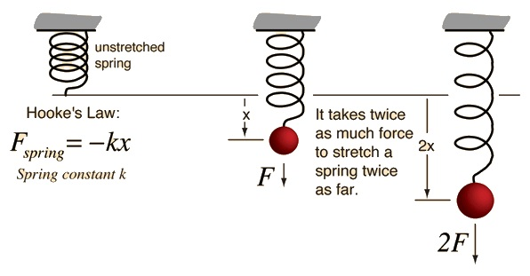
Hooke’s Law:
force that is applied to spring is directly proportional to the displacement.
If the spring is un stretched, there is no net force on the mass or the system is in equilibrium.
if the mass is displaced from equilibrium, the spring will exert a restoring force, which is a force that tends to restore it to the equilibrium position.
03

Slide 5
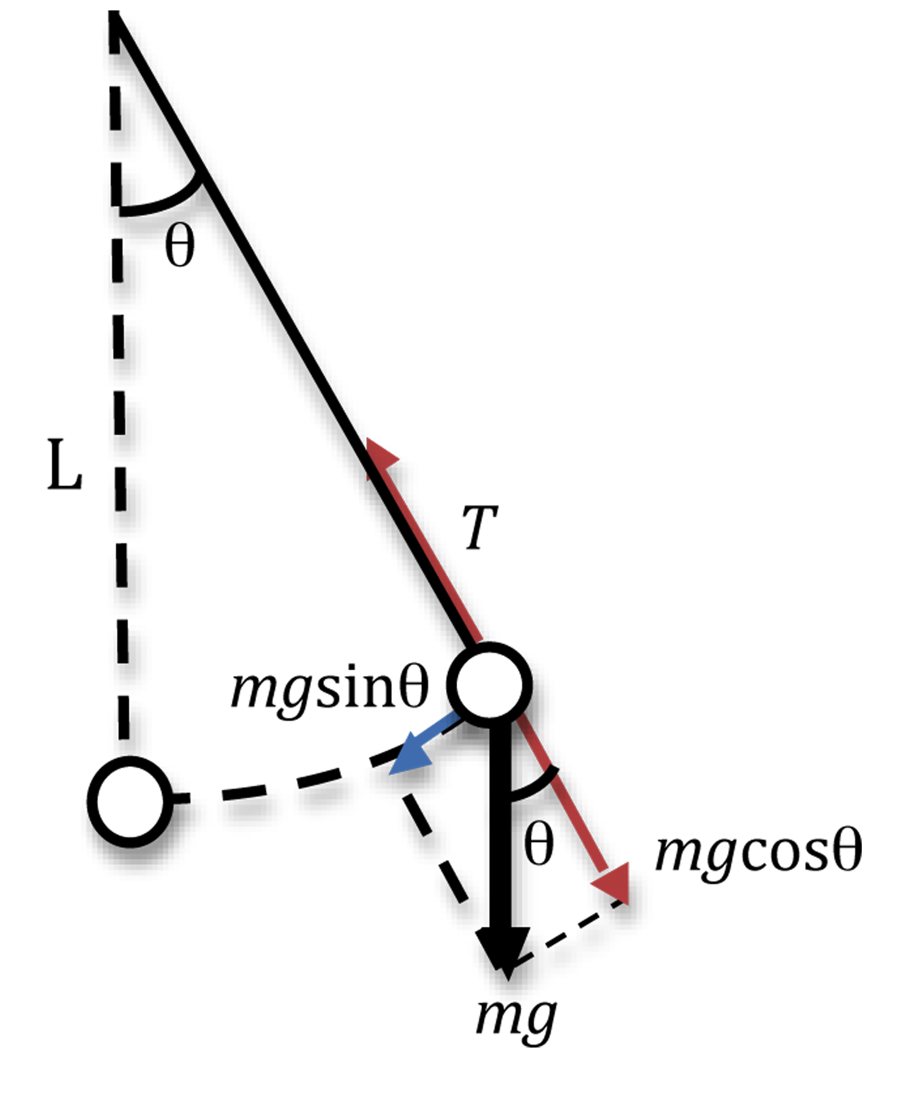
04
Simple pendulum:
A simple pendulum is idealized model consist of a point mass suspended by an inextensible string of length l fixed
When pulled to one side of its equilibrium position A to the position B through a small angle θ and released, it starts oscillating to and over the small.

Slide 6
05
Energy conservation in Simple harmonic motion:
if the friction effect are neglected, total mechanical energy of vibrating mass spring system remains constant
The velocity and position of the vibrating body are continually changing
The kinetic and potential energies also change, but their sum must have the same values at any instant

Slide 7
07
Reference:
https://en.wikipedia.org/wiki/

Slide 8


Slide 9


